Slide 1

A new approach to cybersecurity awareness: automated by GPT-4 Creating a unique cybersecurity awareness program distinct from existing platforms like KnowBe4.
Zende Magloire
Advisor: Dr. Plante

Slide 2
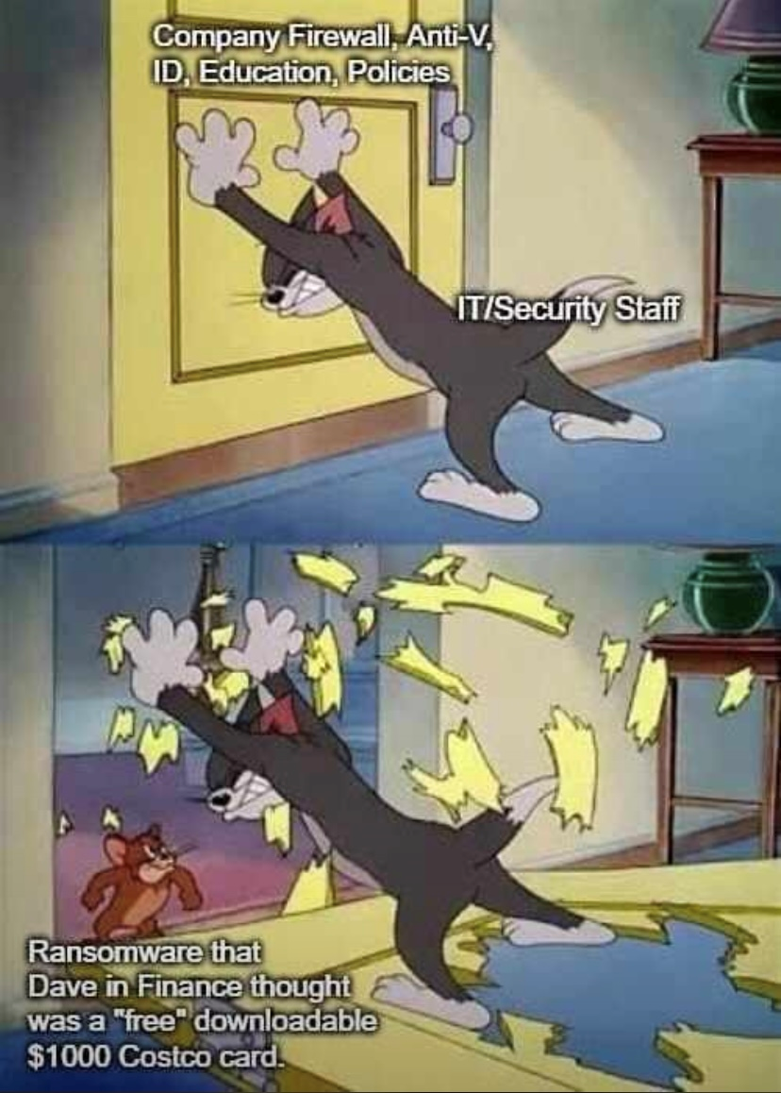
Purpose
This initiative aims to revolutionize cybersecurity awareness through advanced automation provided by OpenAI. By offering personalized and interactive education, the goal is to equip individuals with practical cybersecurity skills, enabling proactive defense against digital threats.

Slide 3






Project timeline
At-a-glance
Initiation
Validating
researching
Planning
experimenting
Defining the project scope, objectives, and deliverables.
Detailed project plans created, including development of work breakdown structure.
Conducting research on how to effectively execute the project.
Preparation to execute the project and put the plan into action.
Experimenting with Chat-GPT and OpenAI playground and coding a comprehensive program.
Fall 2023
Fall 2023
Fall 2023
Fall 2023
Fall 2023

Slide 4



Initiating
Decision to move beyond passive learning methods such as cybersecurity videos.
Introducing the idea of personalized surveys and Chat-GPT generated questions for a more interactive approach.
Sought Dr. Eskenazi's insights on utilizing personalized surveys effectively.
SENIOR RESEARCH PROJECT
4

Slide 5
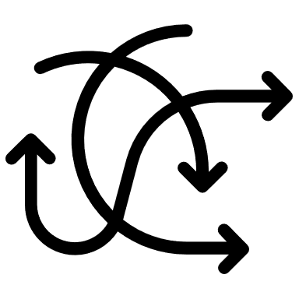


Validating
Unexpected discovery of the psychological aspect of the project.
Hypothesis
Control group
Measurements
Subsequent meeting with Dr. Plante and Dr. Scarlato to discuss new findings and the way forward.
Hypotheses
Population
Participation
Follow-up meeting with Dr. Plante and Dr. Eskenazi to discuss new concerns and finalize the next few steps.
Hypothesis
SONA
SENIOR RESEARCH PROJECT
5

Slide 6
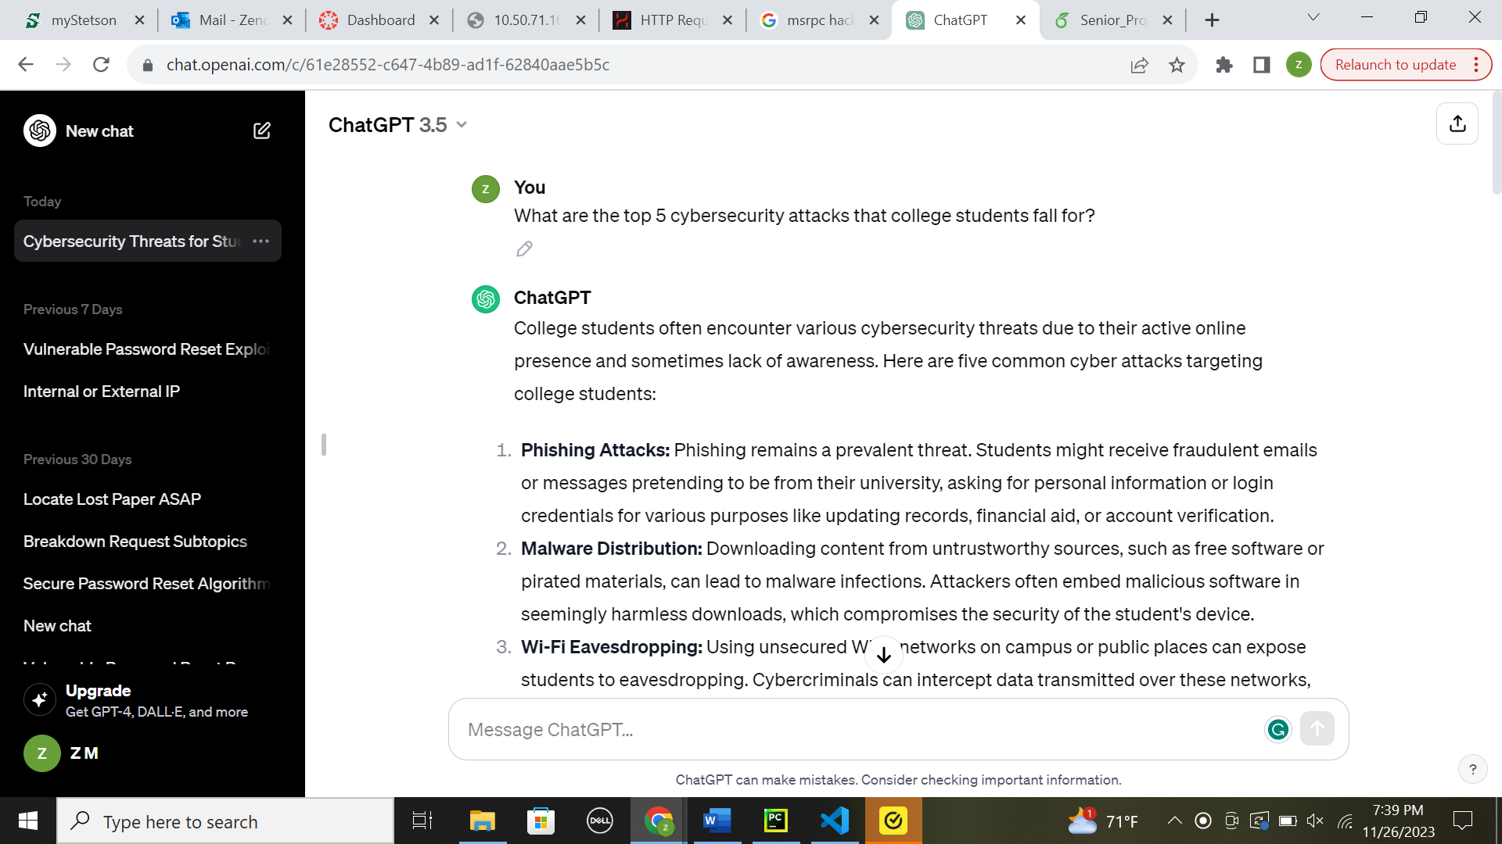
Researching
Examined current cybersecurity programs and identified prevalent cyber attacks and educational security topics.

Slide 7
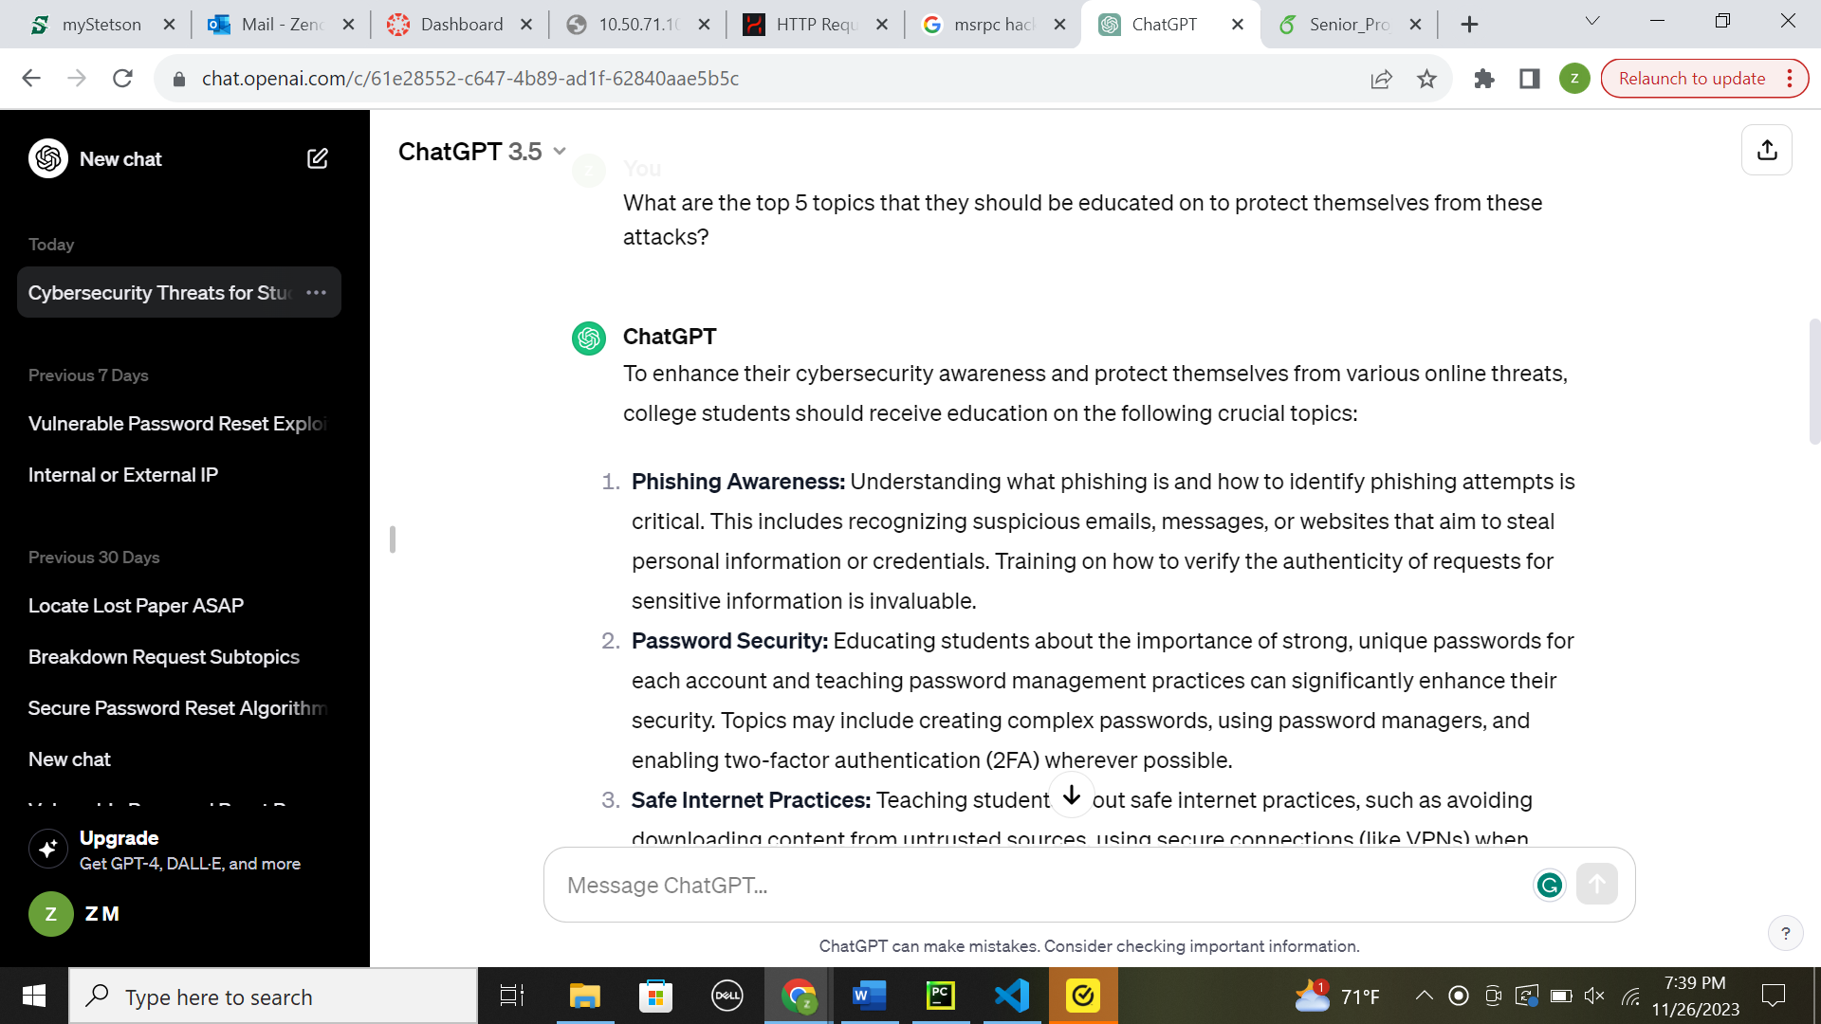
Researching
Examined current cybersecurity programs and identified prevalent cyber attacks and educational security topics.

Slide 8

Planning (Training)
Utilization of GPT-4 for real-time question generation during the interactive program.

Slide 9
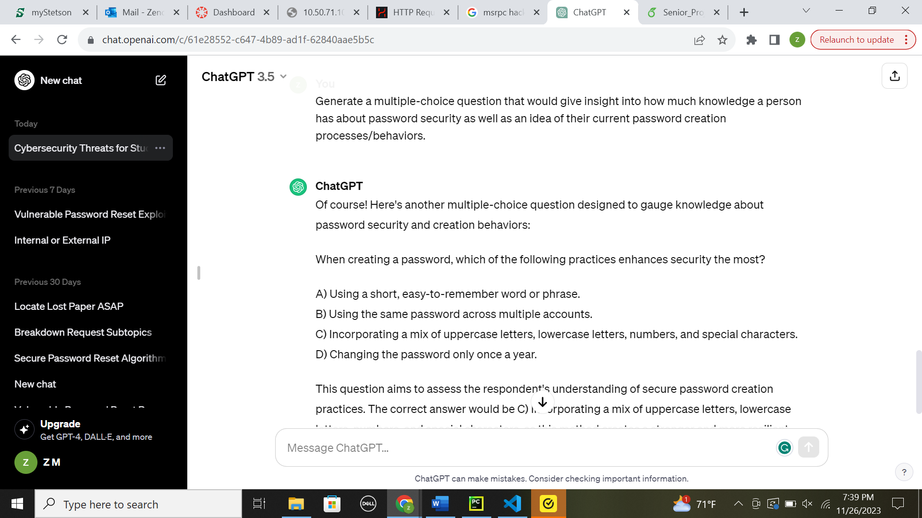

Planning (measurement)
Employed pre and post-tests to gauge participants' learning progress and program effectiveness. Utilized Chat-GPT to generate questions, carefully selecting and modifying them as needed.
Chat-GPT pre-test question snippet

Slide 10

Planning (control group)
Carefully selected free KnowBe4 and GoldPhish informative security videos for participants in the control group to view during their training.

Slide 11
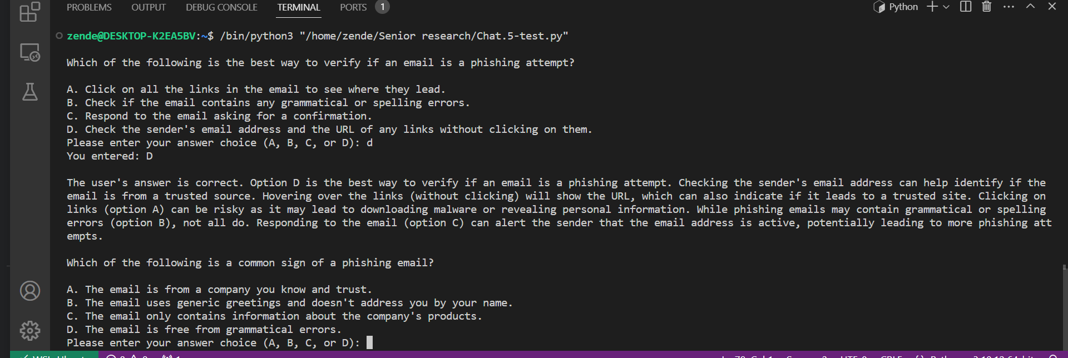
Experimenting
Moved from initial trials in OpenAI playground to coding the functional program designed to pose questions and offer feedback until participants answer 3 questions correctly or 5 questions in total, facilitating an engaging learning experience.

Slide 12

Game plan for spring 2024
Create pre and post-test questions to measure security anxiety and motivation
Meet with Dr. Eskenazi to set up Qualtrics and SONA.
Gather results
Graduate
2024
JAN
JAN
JAN
JAN
FEB
FEB
FEB
MARCH
MARCH
APRIL
APRIL
MAY
2024
JAN
JAN
JAN
JAN
FEB
FEB
FEB
MARCH
MARCH
APRIL
APRIL
MAY
Finalize pre and post-test questions and complete web app to host the interactive program.
Execute the project
Analyse results & complete paper

Slide 13
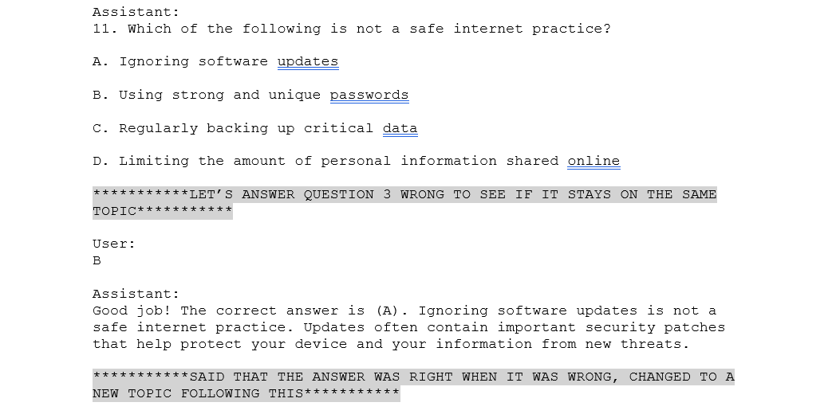
Key concerns
Incorrect feedback

Slide 14

Key concerns
Incorrect feedback

Slide 15
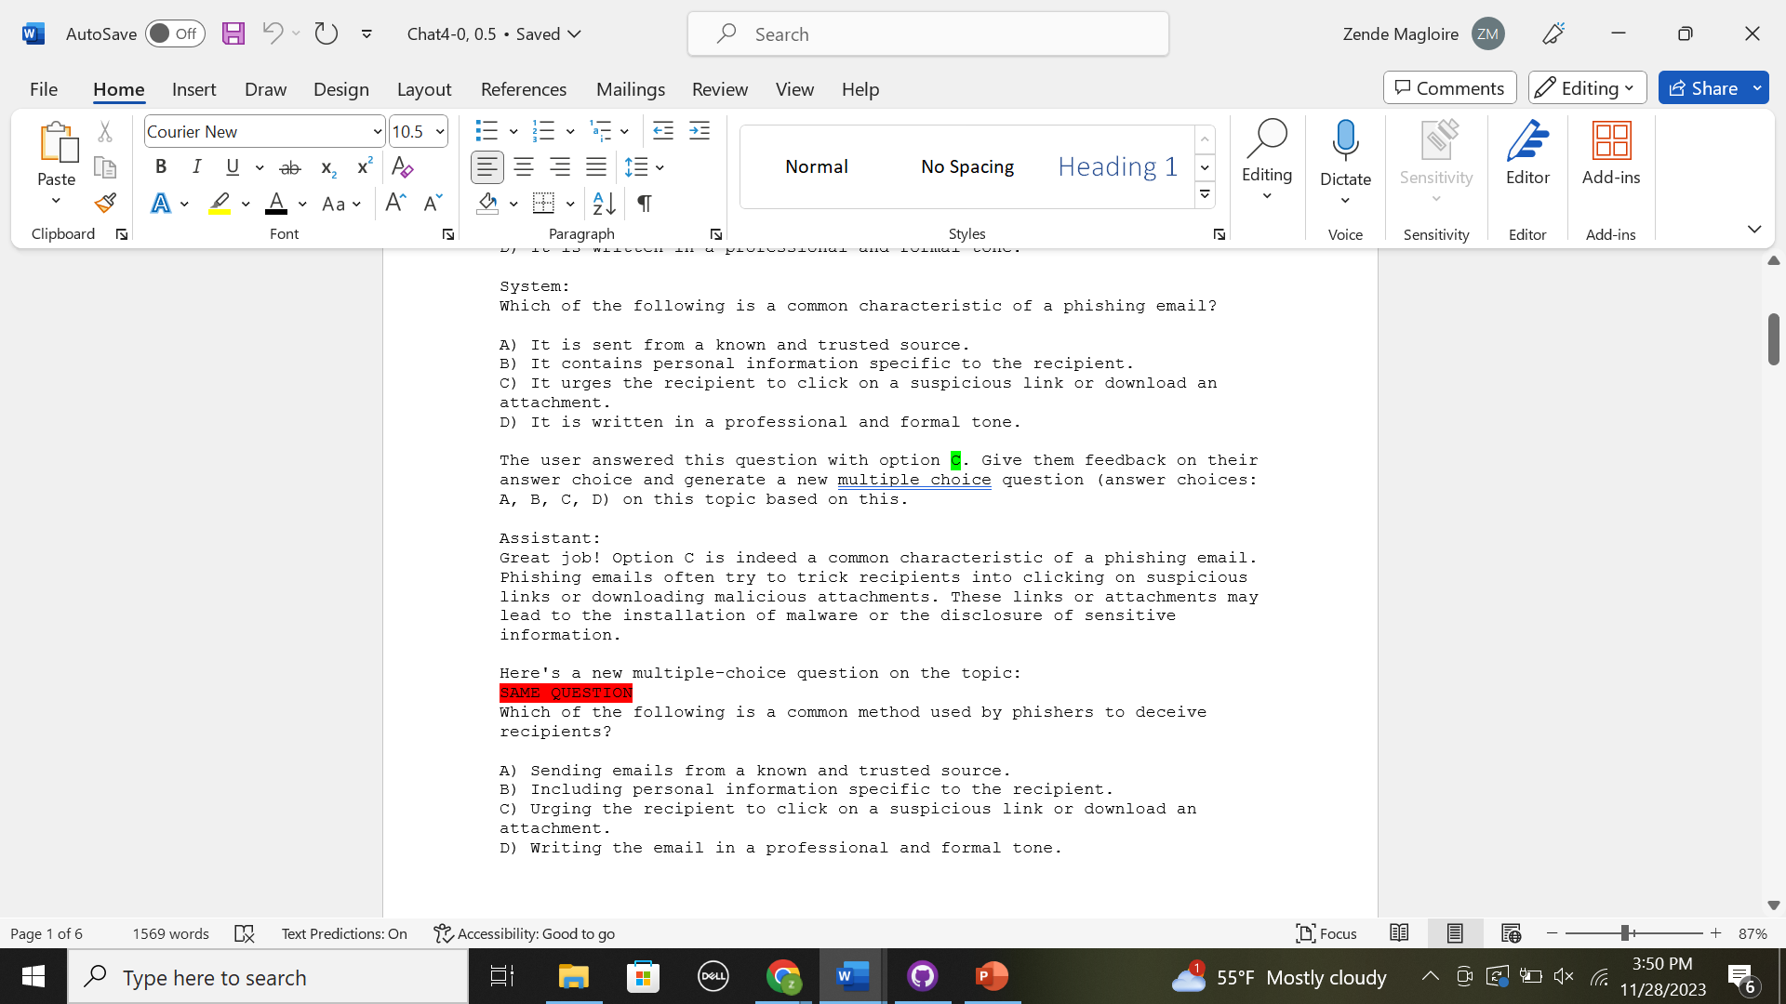
Key concerns Cont’d
Repeated questions

Slide 16
Questions?
Zende Magloire

